Slide 1
Gravity

Slide 2
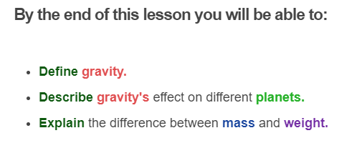
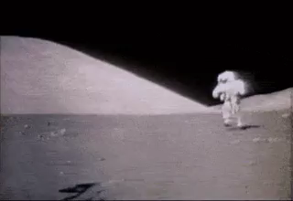

Slide 3
Gravity (also known as gravitational force) is a non-contact force that acts on everything on Earth.
Gravity is an attraction between two masses. It pulls objects together. You don't even need to be standing on the surface of the Earth for it to affect you!

Slide 4
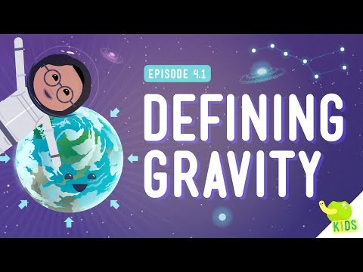

Slide 5
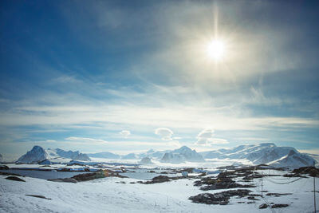
Gravity is only noticeable for really big masses, such as the Earth.
The Earth's gravity holds everything close to the Earth, like all the people, trees and buildings.
Gravity on Earth pulls things towards the centre of the Earth. This is why you can walk on the south pole, on the very bottom of the Earth, and not fall off!

Slide 6
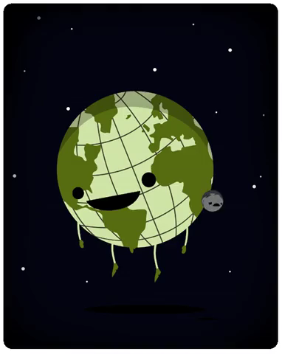
Gravitational force is responsible for many things that happen in our universe.
The Moon is kept in orbit because the Earth exerts a gravitational force on it. As the Moon moves, the Earth continually pulls on it. The Moon does not crash into the Earth because it is moving at a certain speed, which is just fast enough to keep it moving around the Earth in an orbit.

Slide 7
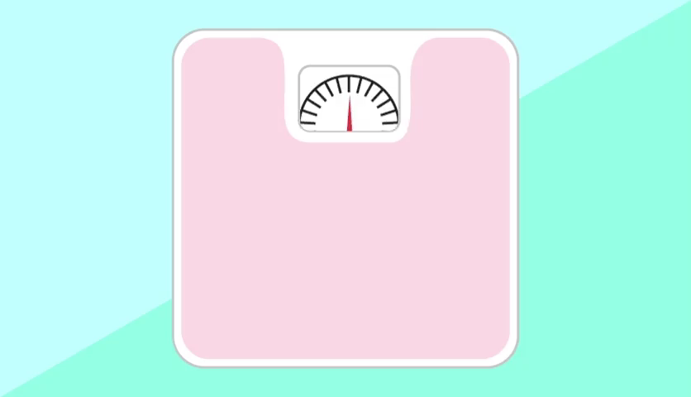
What is the difference between mass and weight?
In everyday life, the terms mass and weight are interchangeable. However, in physics they have special meanings.
Mass is the amount of matter in an object, measured in kilograms (kg). Your mass is the same (constant) wherever you are, even if you go to a different planet!

Slide 8
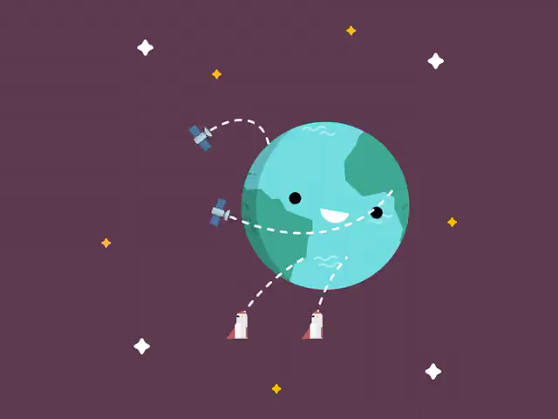
Weight is the force acting on an object due to gravity.
It is the gravitational force between an object and the planet it is sitting on.
It is a way of measuring the effect of gravity on objects on the surface of a planet.
Weight is measured in newtons, just like every other force.

Slide 9
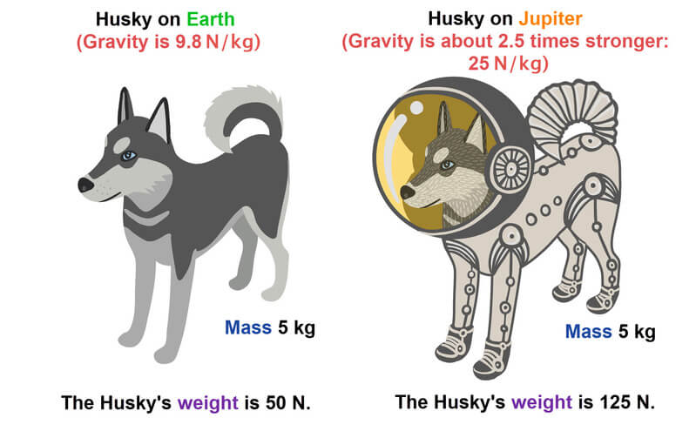
Gravity is different on the different planets in our Solar System.
For example, the gravity on Jupiter is about 2.5 times stronger than on Earth!
An object's weight will change on different planets where the strength of gravity is different.
You weigh less on the Moon than on the Earth because gravity is weaker on the moon.
Check out this puppy explorer below for an example of how weight changes on different planets.

Slide 10
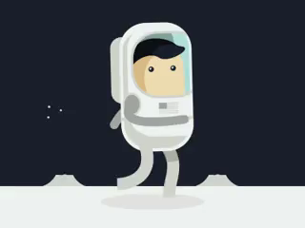
How does mass affect weight?
Your weight changes on planets with different gravity to Earth, however your mass is always the same, no matter where you are!
Two objects with different masses will have a different weight force on Earth.
An object with a greater mass will have a stronger weight force than an object with a smaller mass.

